Slide 1
INFORMATION SYSTEMS
Overview
INFORMATION SYSTEMS AND MANAGEMENT

Slide 2
Data Vs. Information
Data:
Raw unorganized facts
Information:
A collection of facts organized in such a way that they have additional value beyond the value of the facts themselves.
Defining and organizing relationships among data creates information.

Slide 3
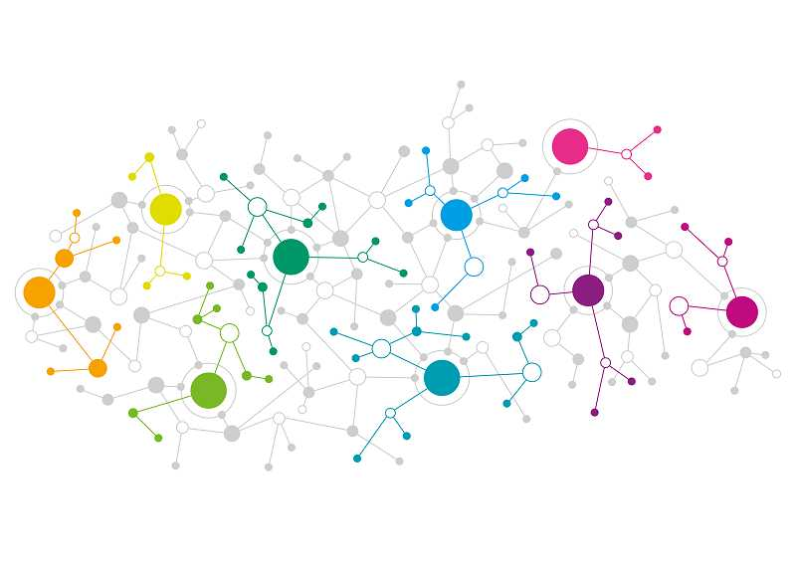
System
A system is a set of elements or components that interact to accomplish goals.
Notes:
a set of things working together as parts of a mechanism or an interconnecting network; a complex whole

Slide 4
Information Concepts
Process:
A set of logically related tasks performed to achieve a defined outcome.
Knowledge:
An awareness and understanding of a set of information and ways that information can be made useful to support a specific task or reach a decision

Slide 5
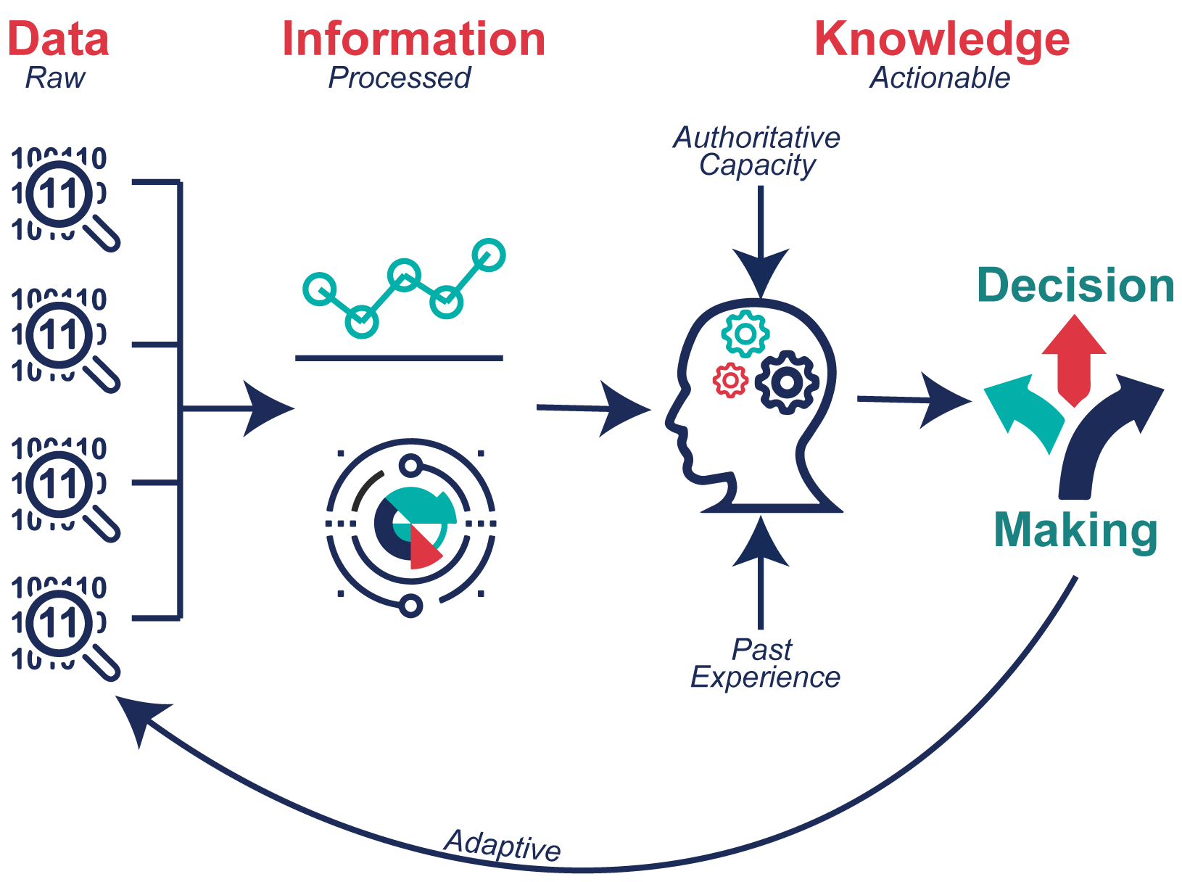

Slide 6
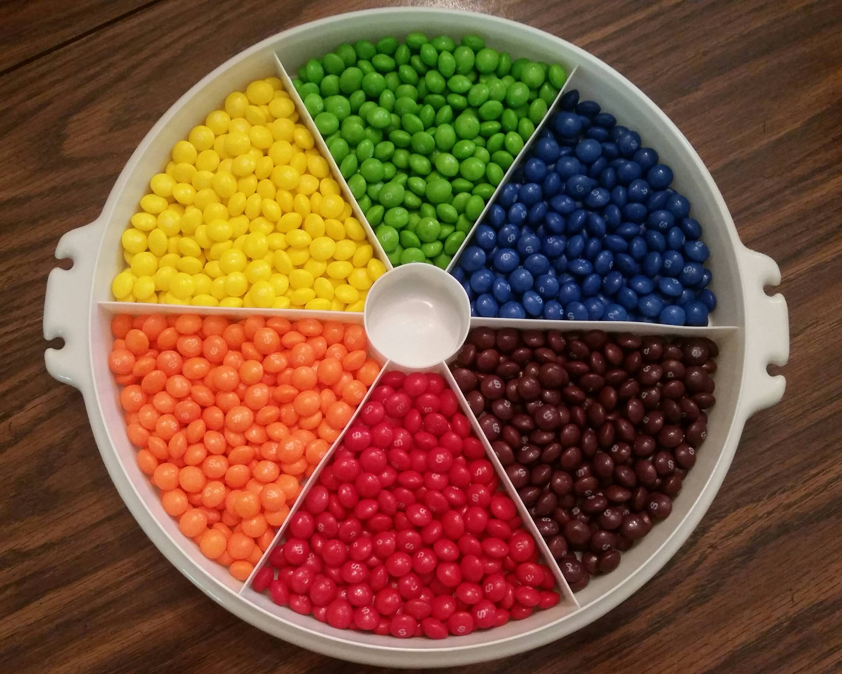
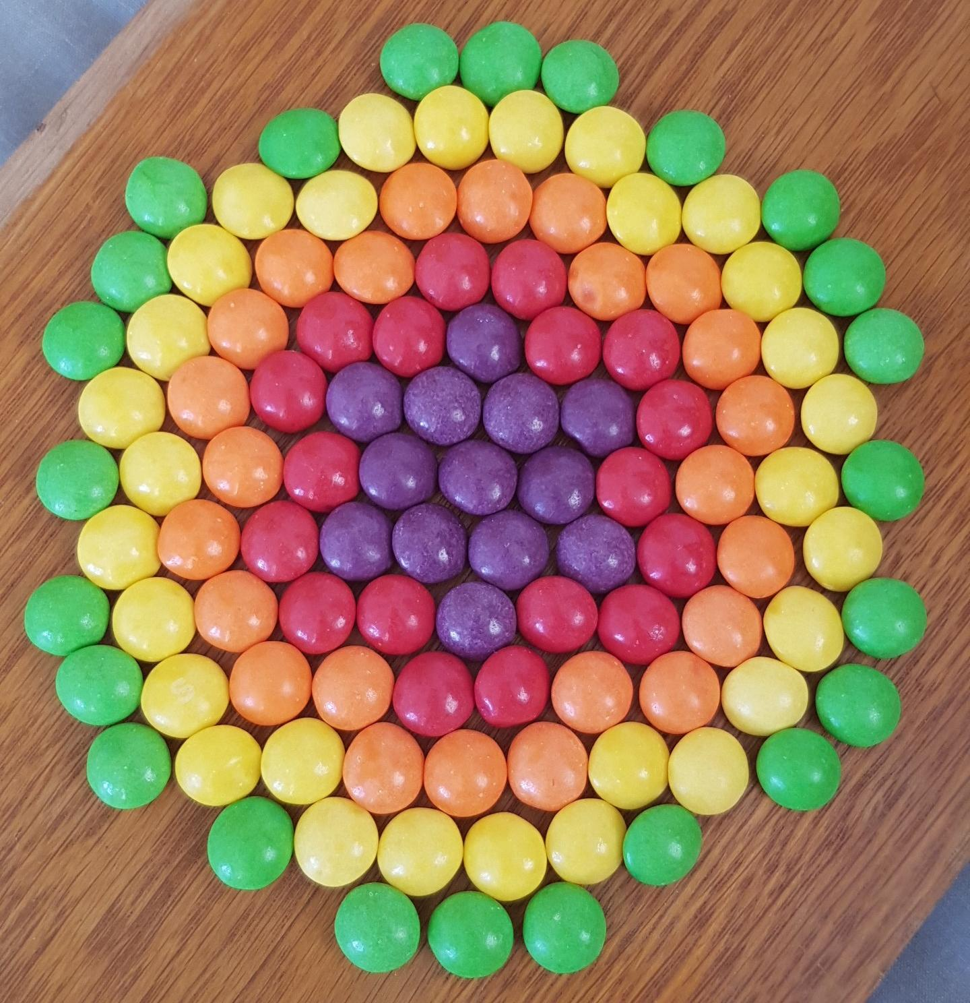


Slide 7
An Introduction to Information Systems
Information System:
An information system
is a set of interrelated
components that collect, manipulate, store data and disseminate information and provide a feedback mechanism to monitor performance.
Notes:
information system, an integrated set of components for collecting, storing, and processing data and for providing information, knowledge, and digital products.

Slide 8
What is an Information System?
An organized combination of people,
hardware, networks, collects
software, communications
and data resources that data, transforms it, and
disseminates information.
Notes:
Thus, the above definition aims at describing an information system in two ways:
The different components that makeup an information system
And the roles played by these components in an organization

Slide 9
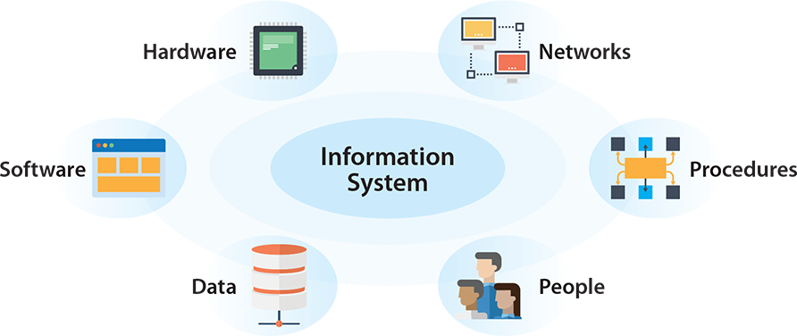
Notes:
1. Hardware
Hardware is the machinery used to create content and manage and communicate information. This includes the physical parts of a computer system, such as the computer itself and the monitor, keyboard, scanner, and printer.
2. Software
Software programs are machine-readable instructions that direct the circuitry within a system's hardware to create, edit, organize, process, and analyze information. Examples include operating systems, spreadsheet and word processing software, and graphic design applications.
3. Data
Data is a collection of information that can be organized, analyzed, and utilized to better manage, understand, and communicate the information. Information is organized using databases, which are collections of related data so that groups of information, or records, can be stored and retrieved for a useful purpose. Typical examples of databases include employee records, product inventory, and product catalogs. In Unit 6, we will discuss databases in more detail.
4. People
People are the most important component in information systems. Without people, information systems cannot function. This includes anyone who uses or maintains the systems. Everyone who works in business, from someone who pays the bills to the person who hires and fires, uses information systems.
5. Procedures
For information systems to operate properly, people need to follow procedures. Procedures are the policies, rules, and guidelines that govern the operation of information systems. For example, procedures need to be established for an organization’s accounting system, including who has authorization to access it and at what level. Organizations have to create manuals, file naming conventions, and a variety of other procedures so their information systems perform in the way they were intended. Requiring employees to log in and out of their computers at the start and end of each work day is an important security-related procedure.
6. Networks
While they may not always be required for every information system, networks are vital in today’s virtually connected society. A network is how computers and other technologies within an information system communicate with one another. Organizations need networks to send emails, share files, stream videos, hold online meetings, and a multitude of other tasks. If you have access to the Internet in your home, you have a network.

Slide 10
The Value of Information
The value of Information is directly linked to how it helps decision makers
achieve their organization’s goals.

Slide 11
CBIS (Comp. based Info Sys)
A computer based informatization system is a combination of people, IT and business processes that help
management
in taking carry out the
important business
decisions to
successfully

Slide 12
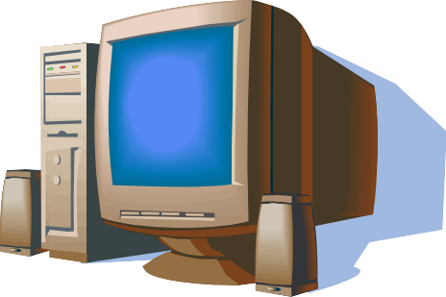
CBIS (Comp. based Info Sys)
Hardware:
Computer Equipment
Software:
Computer Programs
Databases:
An organized collections of facts

Slide 13
CBIS
Enables organizations to carry out their processes and tasks through effective computer networks.
Telecommunications:
Electronic transmission of signals for communication
Networks: Computers and equipment that are connected in a building, around the country, or around the world to enable electronic communications.
Internet: The world’s largest computer network, consisting of thousands of interconnected networks, all freely exchanging information.
Intranet: An internal network based on Web technologies that allows people within an organization to exchange information and work on projects.
Extranet: A network based on Web technologies that allows selected outsiders, such as business partners and customers, to access authorized resources of a company’s intranet

Slide 14

CBIS
People
Procedures:
Strategies, policies, methods, and rules for using a CBIS.

Slide 15
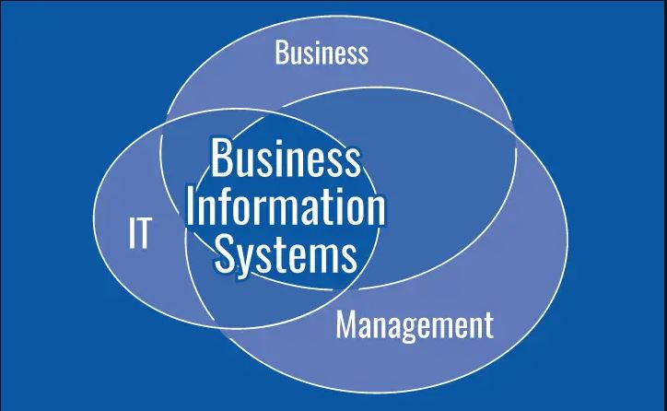
Business Information Systems
Business information systems provide information that organizations use to manage themselves efficiently and effectively, typically using computer systems and technology.
Information can be used to support forecasting, planning, control, coordination, decision making and operational activities
Notes:
What is the business information system?

Slide 16
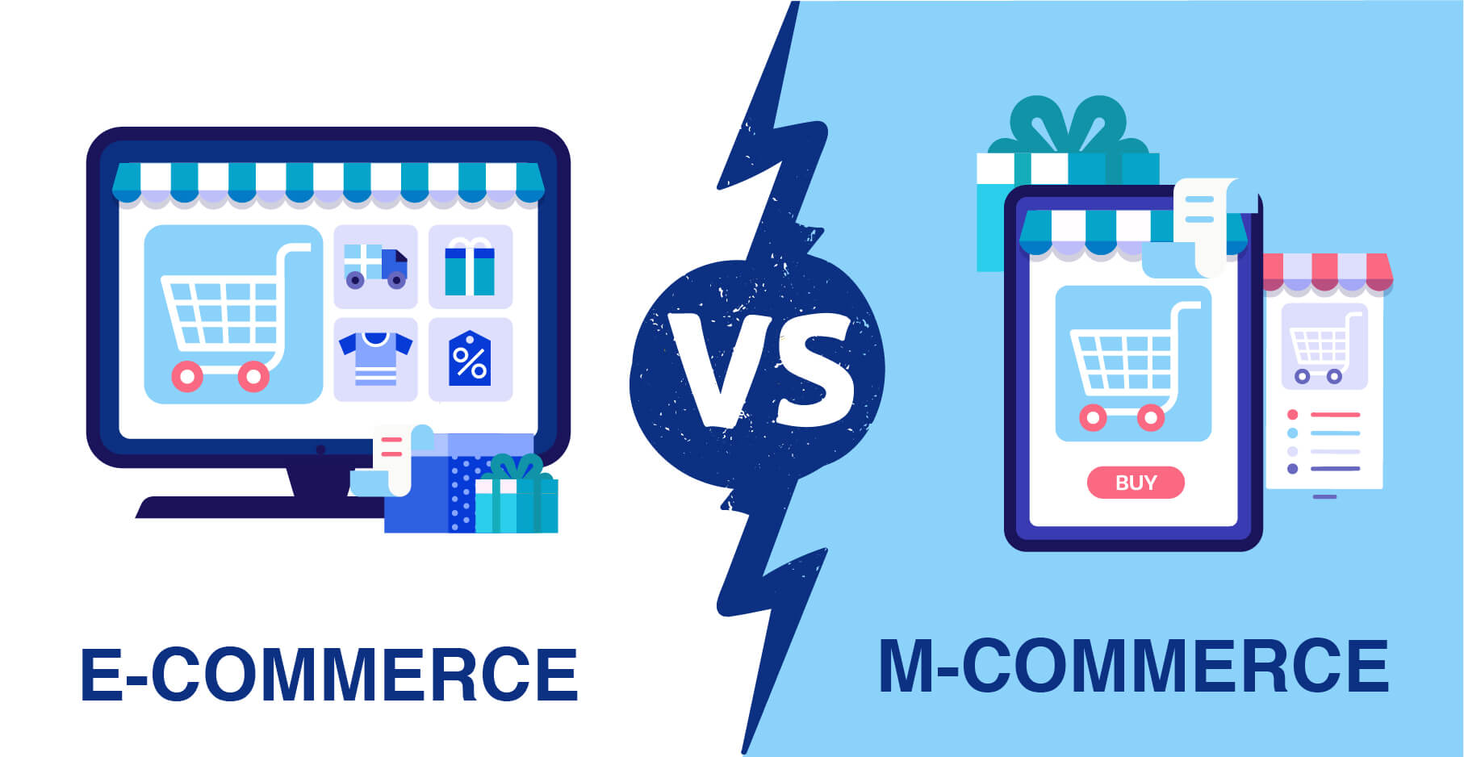

Slide 17
Electronic and Mobile Commerce
E-Commerce:
Any business transaction executed electronically between companies (business-to-business, or B2B), companies and consumers (business- to-consumer, or B2C), consumers and other consumers (consumer- to-consumer, or C2C).
M-Commerce:
The use of mobile, wireless devices to place orders and conduct
business
Relies on wireless communications

Slide 18
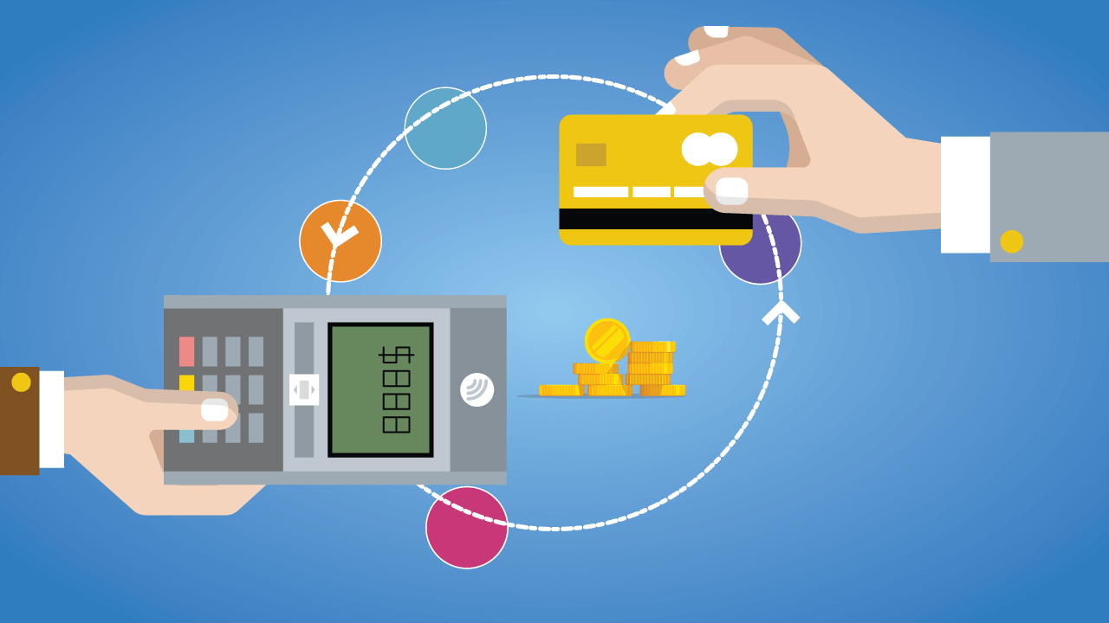
Transaction Processing System

Slide 19
Transaction
A transaction is any business-related exchange such as payments to employees, sales to customers, or payments to suppliers.
Transaction Processing System (TPS)
TPS is an organized collection of people, procedures, software, databases, and devices used to perform and record business transactions.

Slide 20


Slide 21
ERP
ERP stands for Enterprise Resource Planning and refers to software and systems used to plan and manage all the core supply chain, manufacturing, services, financial and other processes of an organization.
Notes:
Enterprise resource planning (ERP) refers to a type of software that organizations use to manage day-to-day business activities such as accounting, procurement, project management, risk management and compliance, and supply chain operations.

Slide 22
Management Information System:
A system used to provide routine information to managers
reports
and decision makers. MISs typically provide standard
generated with data and information from the TPS or ERP
Decision Support System:
A system used to support problem- specific decision making

Slide 23
Remember!
The focus of a DSS is on making effective decisions. Whereas an MIS helps an organization “do things right,” a DSS helps a manager “do the right thing”.

Slide 24
Information Systems in Society
Security, Privacy, Ethical Issues in Information Systems and the Internet.

Slide 25
Information System Activities
Input of Data Resources
Process Data into Information
Output of Information

Slide 26
Input of Data Resources
Data entry Editing
Machine readable
Source documents
Formal record of a transaction
User interface
How users interact with information system
Optical scanning; menu; prompts; fill in blanks

Slide 27
Process Data into Information
Calculate
Compare
Sort
Classify
Summarize
The quality of the data must be maintained by a continual process of correcting and updating activities

Slide 28
Output of Information
Transmit information to users
Display; paper; audio
Storage of data
Data are retained in an organized manner
Fields; records; files; data bases
Control of system performance
Feedback must be monitored and evaluated to determine if the information system is meeting established performance standards

